Slide 1


Slide 2

ONLINE COURSE PORTAL
By
Sai Santhosh
Bharath Reddy
Varalakshmi
Hemalatha

Slide 3
PROBLEM STATEMENT
Education during the pandemic has become difficult. We need a platform so that no one stops their learning and maintain their consistency in studies. So we came up with a portal that gives an opportunity to maintain the streak in learning with a new way of learning.

Slide 4
SHORT DESCRIPTION
Online Course Portal is one of the very efficient and one of the effective platform for learning.
Different courses are available so that the student have maximum benefit, where students are feeling new experience during their studies.
Students who are willing to study more, can further
explore their interested courses.
This online courses helped more to the student in the pandemic situation.

Slide 5
TECHNOLOGIES
The technologies used our project
Frontend:
HTML, CSS, JavaScript, Bootstrap
Backend:
Java, Spring Boot, MySQL,AWS

Slide 6
TOOLS
The tools used in our project
Springtoolsuite
MYSQL Workbench

Slide 7
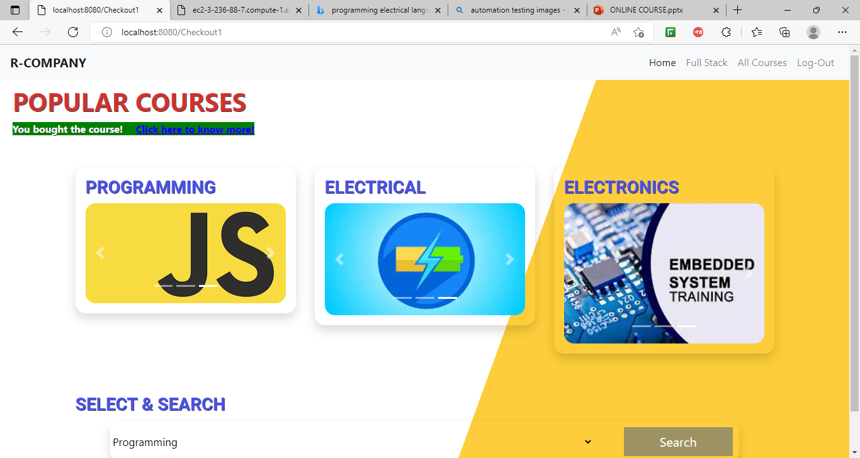
RESULTS

Slide 8
THANK YOU

